Slide 1


Slide 2

Checking the old Lesson: (6’minutes)
Change these sentences from active to passive and write the form.
1.They are building a new motorway
->A new motorway is being built by them
S+(am,is ,are) +being+V^{pII} +by +O
2.I haven’t seen him for three years
->He hasn’t been seen by me for three years
S+have/has +been +V^{pII} +by +O

Slide 3
WHAT CAN YOU SEE IN THESE PICTURES?
WHERE DO THEY LIVE?

Slide 4


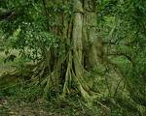
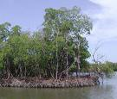
PLANTS AND TREES

Slide 5
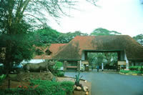
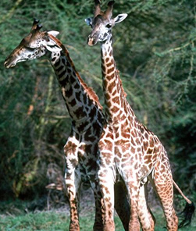
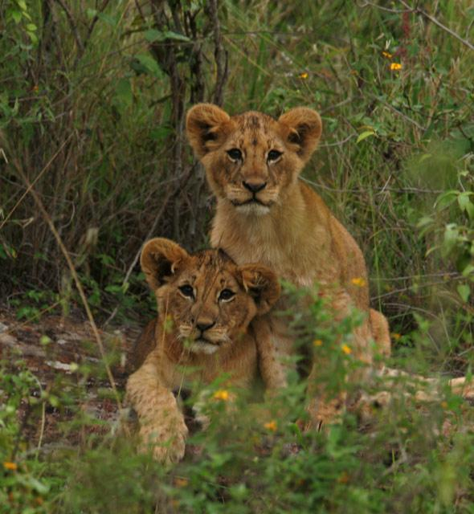
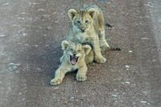
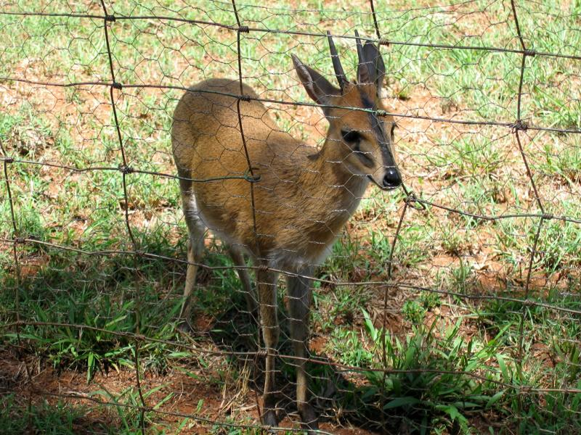
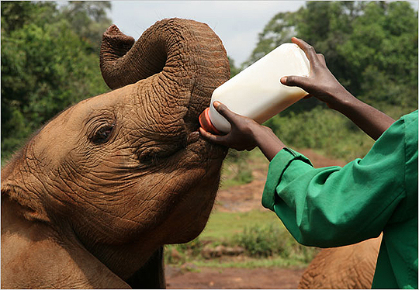
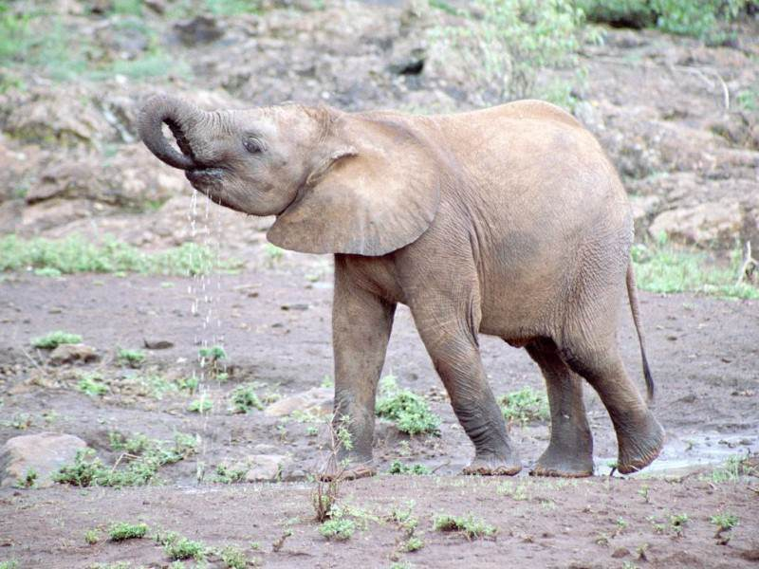
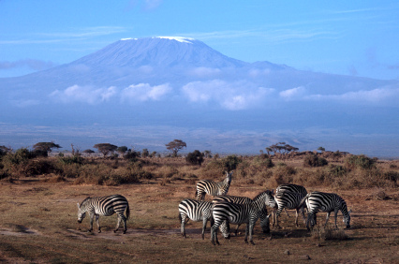
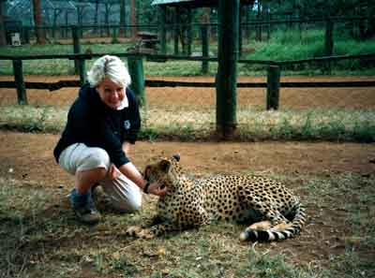
ANIMALS

Slide 6
In the forest
or in the National Park.

Slide 7

A- READING

Slide 8

A- READING
A. Before you read
I. Discuss the questions:
B. While you read
1. Have you ever been to a National parks ? Yes or No ???
Activity 1
2. Can you name some of the National parks in Viet Nam and in the World ?
Activity 2
Activity 3

Slide 9
A- READING
A. Before you read
National Parks In Viet Nam
- Cat Ba N.p (Hai Phong)
- Con Dao N.p (Kien Giang)
- Tam Dao N.p (Vinh Phuc)
- Tram Chim N.p (Dong Thap)
Cuc Phuong N.p (Ninh Binh)
U Minh Thuong N.p (Kien Giang)
Ben En (Thanh Hoa)

Slide 10
A- READING
A. Before you read
National Parks In the world
- Nairobi – Kenya
Everglades – USA
Komodo – Indonesia
Grand Canyon – USA
Kakadu park – North Australia

Slide 11
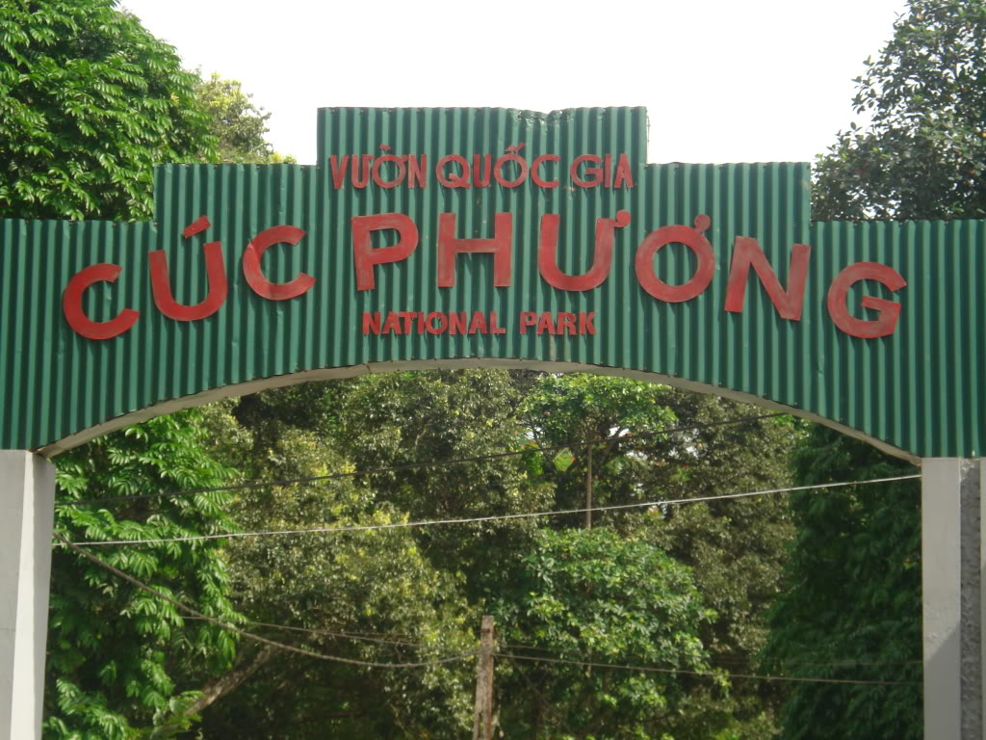
A- READING
A. Before you read
Read the passsages, and then do the tasks that folow.
B. While you read
Activity 1
Activity 2
Activity 3

Slide 12

A- READING
A. Before you read
II. Vocabuaries:
Contain:
Establish:
Orphan:
Survival:
Sub- tropical:
Contamination:
[kən'tein]
(v) Chứa đựng, bao gồm
[is'tæbli∫]
(n) lập, thành lập, thiết lập,
['ɔ:fən]
(adj, n, v) mồ côi.
[sə'vaivl]
(n) sự sống sót, sự tồn tại
[,sʌb'trɔpikl]
(adj) cận nhiệt đới
[kən,tæmi'nei∫n]
sự làm bẩn,
sự nhiễm (bệnh)

Slide 13
A- READING
Read the passsages, and then do the tasks that folow.
Cuc Phuong National Park, Vietnam
Cuc Phuong National Park is located 160 kilometres south west of Hanoi. It is the first of Vietnam's nine national parks to be established, and it contains over 200 square kilometres of rainforest. Tourists go there to study butterflies, visit caves, hike mountains and look at the 1,000-year-old tree. The best time to visit the park is during the dry season, from October to April, when the rainy season is over.
Nairobi National Park, Kenya
Nairobi National Park is Kenya's smallest park, but you may be surprised at the large variety of animals that live there. Visitors, especially children, can go there to learn how to recognise the different species of animals and plants. They also learn about the habits of animals and how one species is dependent upon another for survival. An interesting feature of this park is the Orphanage, where lots of orphaned or abandoned animals are taken care of.
Everglades National Park, USA
Everglades National Park is a sub-tropical wilderness in the southeastern United States. This national park is special because it has plants and animals from both tropical and temperate zones. Due to an increase in population and the use of nearby land for farming, there are toxic levels of chemicals in the water. This contamination has threatened the park and many of the animals in it.
B. While you read

Slide 14
A- READING
A. Before you read
Activity1: Fill in blanks with suitable words
Dang Huy Tru high school was … in 1961.
Nowadays, there is no … of dinosaur.
… region is a place related to an area near a tropical area.
10A3 class … (s) 47 students.
The … of toxic chemicals makes a lot of fish under rivers die.
The children whose parents have passes away are …
a.Contamination
b. Survival
c.Established
B. While you read
d. Orphan
e.Contain
f. Sub- tropical
Activity 1
Activity 2
Activity 3

Slide 15
A- READING
A. Before you read
Activity 2: Read the text again and decide whether the statements are true (T) or false (F).
B. While you read
Statements | True | False
1. Cuc Phuong National Park is located 160 km south east of Hanoi.
2. December would be a suitable time to visit Cuc Phuong National Park.
3. Nairobi National Park, which is small, has an animal variety.
4. Everglades National Park is a sub-tropical wilderness in the south west of the USA
5. Water in Everglades National Park is not only clean but also fresh.

Activity 1
Activity 2

Activity 3




Slide 16

Cuc Phuong National Park, Vietnam
Cuc Phuong National Park is located 160 kilometres south west of Hanoi. It is the first of Vietnam's nine national parks to be established, and it contains over 200 square kilometres of rainforest. Tourists go there to study butterflies, visit caves, hike mountains and look at the 1,000-year-old tree. The best time to visit the park is during the dry season, from October to April, the rainy season is over.
Nairobi National Park, Kenya
Nairobi National Park is Kenya's smallest park, but you may be surprised at the large variety of animals that live there. Visitors, especially children, can go there to learn how to recognise the different species of animals and plants. They also learn about the habits of animals and how one species is dependent upon another for survival. An interesting feature of this park is the Orphanage, where lots of orphaned or abandoned animals are taken care of.
Everglades National Park, USA
Everglades National Park is a sub-tropical wilderness in the southeastern United States. This national park is special because it has plants and animals from both tropical and temperate zones. Due to an increase in population and the use of nearby land for farming, there are toxic levels of chemicals in the water. This contamination has threatened the park and many of the animals in it.
when

Slide 17
A- READING
A. Before you read
Activity 3: Do the matching
Cuc Phuong
B. While you read
Nairobi
Activity 1
Activity 2
Activity 3
Everglades
1- Large variety of plants and animals
4- Old trees and butterflies
2- Plants and animals from both tropical and temperate zone
5- Orphaned and abandoned animals
3- Toxic level of chemical
6- Mountains and caves

